Slide 1

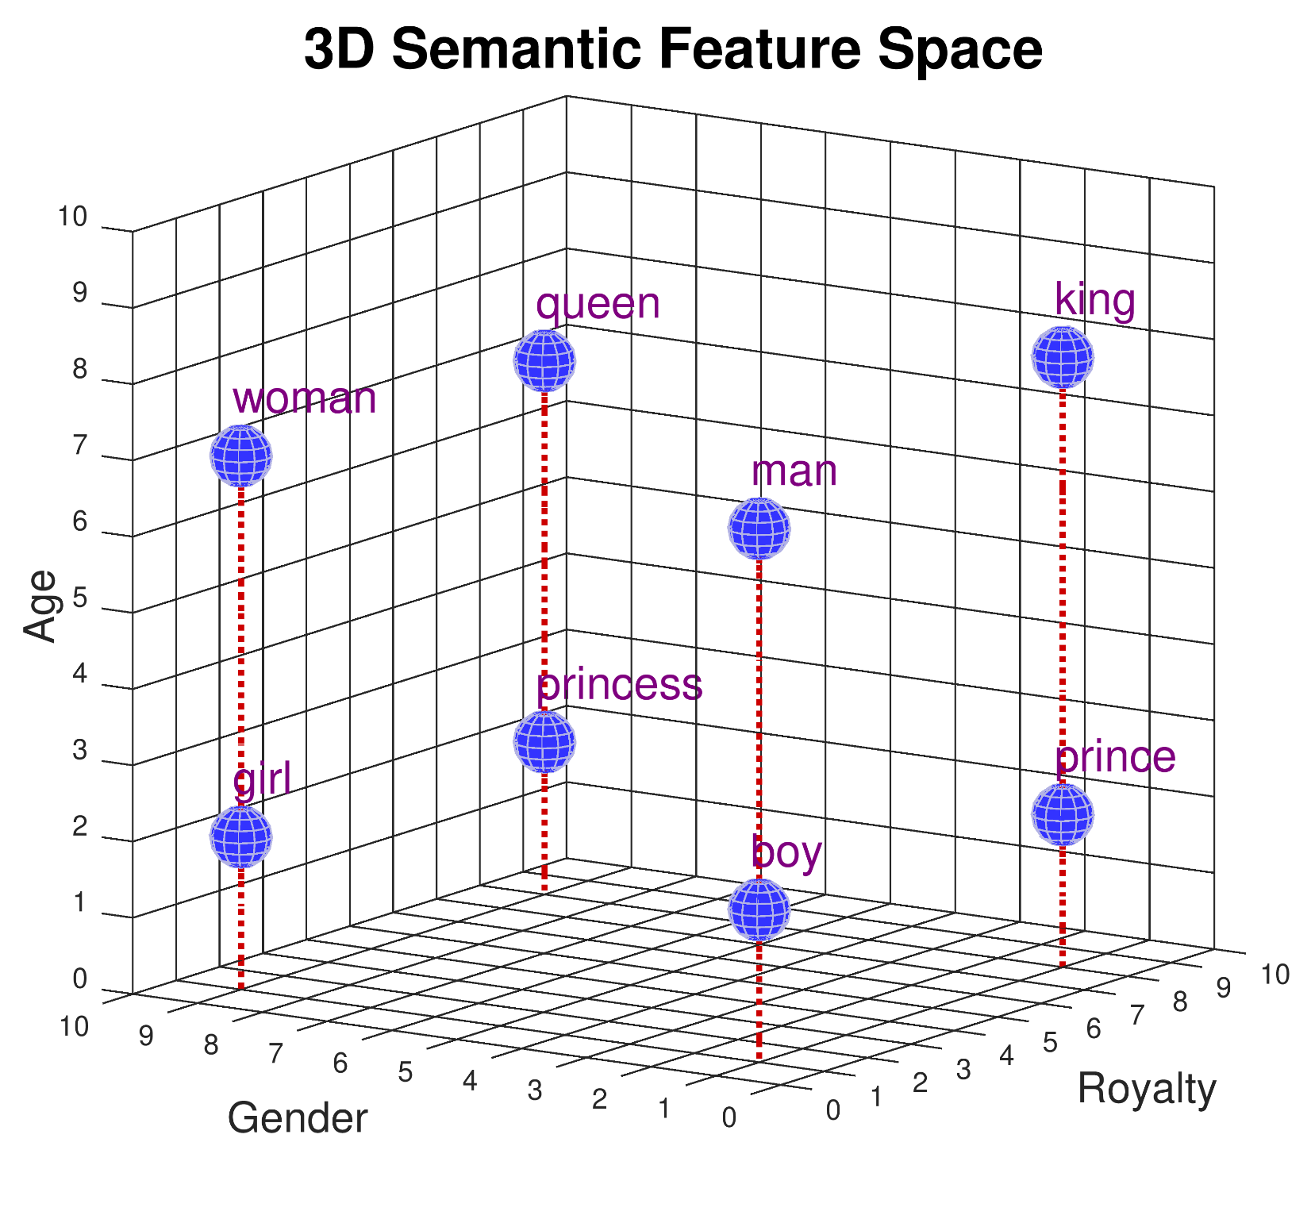

Module 2.4
Word Embeddings
Living and Working with Artificial Intelligence
Developed for the AI4GA (Artificial Intelligence for Georgia) project funded by National Science Foundation awards DRL-2049029 and DRL-2048502.
This work is licensed under the Creative Commons. Attribution-NonCommercial-ShareAlike 4.0 International License. https://creativecommons.org/licenses/by-nc-sa/4.0/

Slide 2
Learning Objectives
Students should be able to:
Explain the notion of semantic feature space
Given a semantic feature space, determine where a word should be located in that space
Demonstrate how to solve analogy problems using vector arithmetic

Slide 3
First 10 minutes for studying~
Quiz on Word Embeddings :)

Slide 4
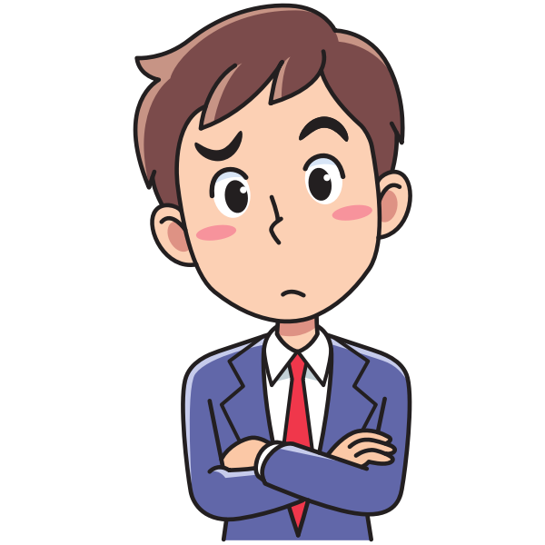
Warm Up:
What is an “apple”?
What do you get when you google “apple”?
What is a “monarch”?
What do you get when you google “monarch”?
What’s going on here?

Slide 5
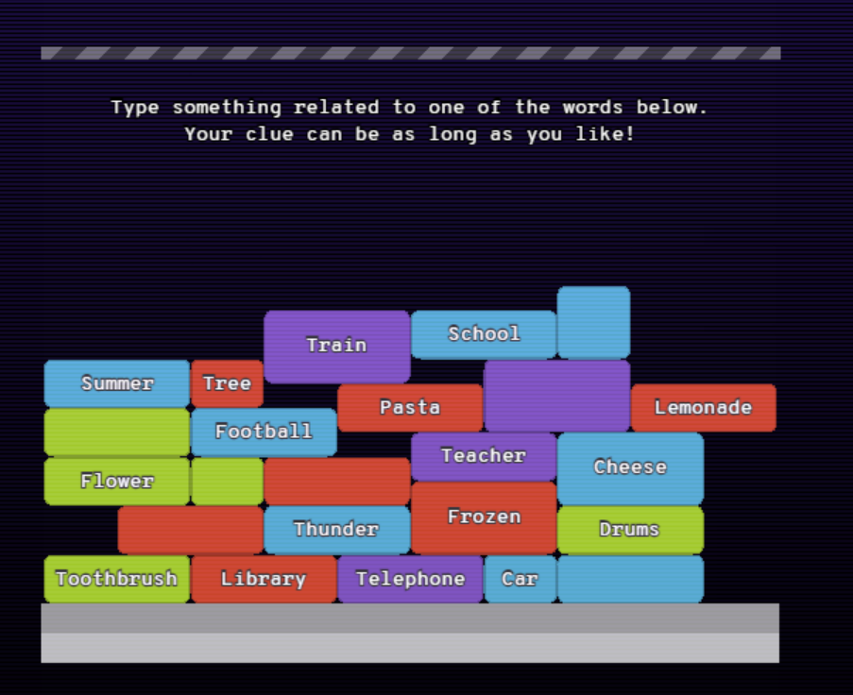
Play Semantris
Play Blocks version
How does the computer know
which words are related?

Slide 6
How does the computer know which
words are related?
Discussion

Slide 7
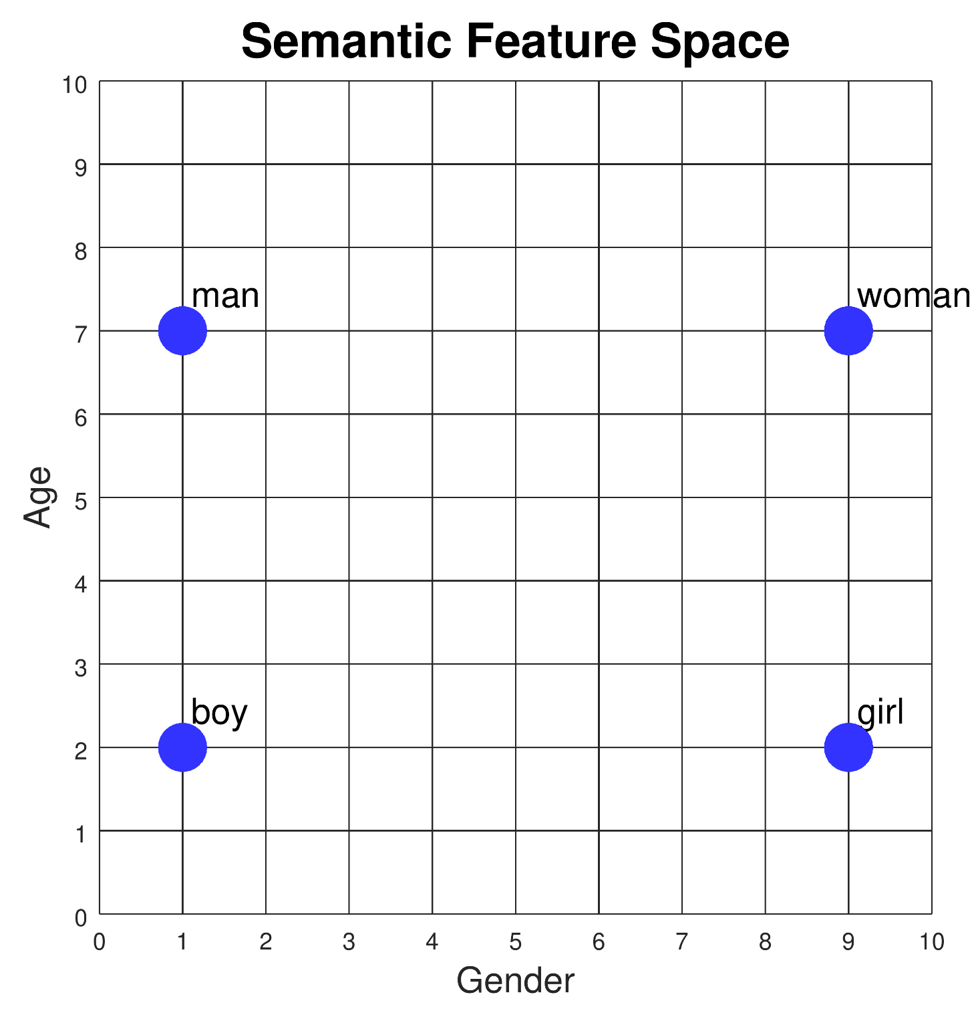
Fill in the missing Feature values
 | Gender | Age
man | 1 | 7
woman
boy
girl | 9 | 2
Notes:
Teacher Resource - See Dave’s tutorial on the word embeddings demo
Student Resource - Student Handout/slides - Students can follow along
Teacher Note: Feature values are coordinate values in this diagram. (Connection to prior mathematical knowledge)
How to use this slide - You can do this as a class using only the slides or create a handout with info on slides 4, 5, and 7.
Answers provided on slices 5 and 6.

Slide 8
Fill in the missing values
 | Gender | Age
man | 1 | 7
woman | 9 | 7
boy | 1 | 2
girl | 9 | 2
grandfather
adult
child
infant

Slide 9
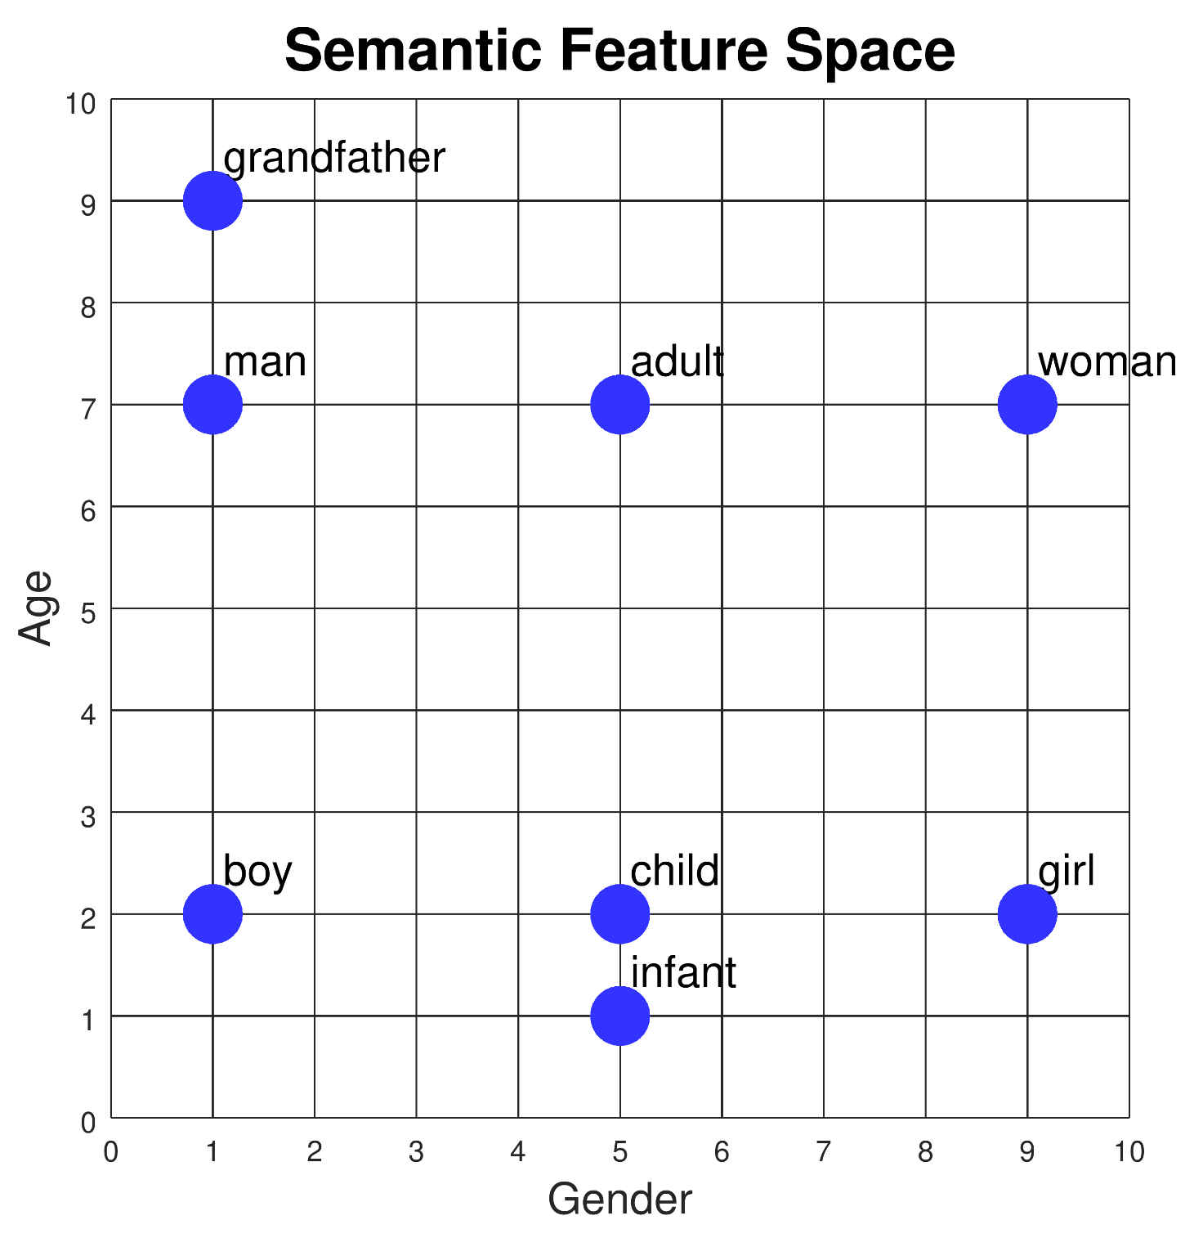
 | Gender | Age
man | 1 | 7
woman | 9 | 7
boy | 1 | 2
girl | 9 | 2
grandfather | 1 | 9
adult | 5 | 7
child | 5 | 2
infant | 5 | 1
Notes:
Teacher Note: There can some variability in the age assigned to grandfather and infant.
Discussion: Where did the students places their dots and why?

Slide 10
How would you represent:
grandmother
grandparent
teenager
octogenarian
Notes:
Add to the Vocabulary List - octogenarian
Teacher Note: No answers provided for this slide. This is just an activity.

Slide 11
More Semantic Dimensions
How would you represent king, queen prince, and princess?
We need another semantic dimension.
What would you call it?

Slide 12
 | Gender | Age | Royalty
man | 1 | 7 | 1
woman | 9 | 7 | 1
boy | 1 | 2 | 1
girl | 9 | 2 | 1
king | 1 | 8 | 8
queen | 9 | 7 | 8
prince | 1 | 2 | 8
princess | 9 | 2 | 8
monarch
Notes:
Teacher Note: The age for King is slightly older than man and queen. The other adults are 7 and King is 8. This imperfection represents real world data (statistics from text corpa) and things are not perfectly symmetric. For example, there are many stories of elderly kings and young queens.
Vocabulary - Monarch - gender neutral royal ruler - Solution: [5, 7, 8]

Slide 13
 | Gender | Age | Royalty
man | 1 | 7 | 1
woman | 9 | 7 | 1
boy | 1 | 2 | 1
girl | 9 | 2 | 1
king | 1 | 8 | 8
queen | 9 | 7 | 8
prince | 1 | 2 | 8
princess | 9 | 2 | 8
monarch | 5 | 7 | 8
Notes:
Teacher Note: The age for King is slightly older than man and queen. The other adults are 7 and King is 8. This imperfection represents real world data (statistics from text corpa) and things are not perfectly symmetric. For example, there are many stories of elderly kings and young queens.
Vocabulary - Monarch - gender neutral royal ruler - Solution: [5, 7, 8]

Slide 14
Semantic Distance
 | Gender | Age | Royalty
man | 1 | 7 | 1
woman | 9 | 7 | 1
boy | 1 | 2 | 1
girl | 9 | 2 | 1
king | 1 | 8 | 8
queen | 9 | 7 | 8
prince | 1 | 2 | 8
princess | 9 | 2 | 8
Is “boy” closer to “girl” or to “queen”?
How can we measure the distance?
Count the number of features where they differ:
boy:girl - 1 feature
boy:queen - 3 features
Measure distance between points using the Pythagorean theorem:
boy:girl distance 8
boy:queen distance 11.75
Notes:
Prior Knowledge Connection - Pythagorean theorem - add picture/slides
Teacher Note Q&A - Have the students identify the feature on which boy and girl differ - > gender
Have the students identify the features on which boy and queen differ - > gender, age royalty

Slide 15
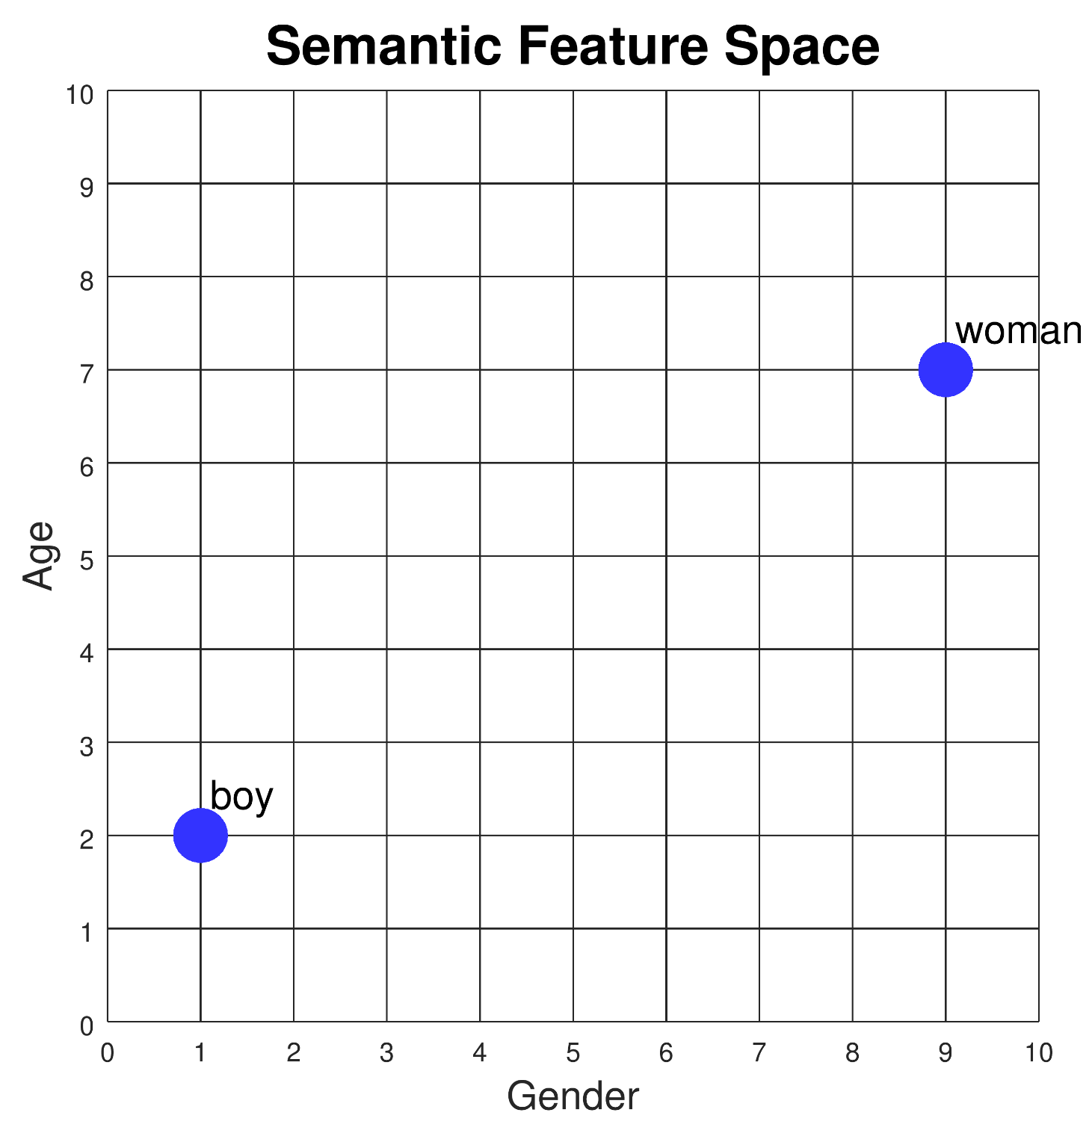
Pythagorean theorem
Measure distance between points using the Pythagorean theorem:
 | Gender | Age
man | 1 | 7
woman | 9 | 7
boy | 1 | 2
girl | 9 | 2
√(8² + 5²) = 9.43
5
8
The distance from boy to woman is 9.43
Notes:
Teacher Note: Feature values are coordinate values in this diagram. (Connection to prior mathematical knowledge)
How to use this slide - You can do this as a class using only the slides or create a handout with info on slides 4, 5, and 7.
Answers provided on slices 5 and 6.

Slide 16
Remember Semantris
research.google.com/semantris
To do what Semantris does, we can select a clue word and measure the distances from our clue to the target words in the blocks.
The target word with the smallest distance should be selected.
Our chosen target: Pasta (red block)
Our clue word: Macaroni
Note another target word might have a smaller distance and be selected instead, e.g., Cheese (blue block) might be chosen because “macaroni and cheese” is a common phrase.

Slide 17
Remember Semantris
research.google.com/semantris
Using multiple words as clues: We can average the clue words together and measure the distance from the average to each of the target words.
Our chosen target: Pasta
Clue words: Macaroni, Spaghetti, Linguini, Italian.

Slide 18
What other types of reasoning could a computer do using semantic feature space?

Slide 19
Lots of stuff!
How Google understands the questions you ask it.
Translating between languages
Writing a fictional story
Summarizing an online article
Solving analogy problems
Notes:
To Do - Make these slides visually appealing

Slide 20
Analogies
“Man” is to “king” as “woman” is to .
AnalogY - A comparison between two things based on their relationships.
Notes:
Vocabulary - Analogies
Teacher Note: Have the students come up with the answer to this analogy
Discussion: How did you come up with this answer?

Slide 21
Analogies
“Man” is to “king” as “woman” is to queen .
Can we use semantic features to solve this problem?
Notes:
Teacher Note: Have the students consider if they can come up with a procedure to solve analogies
Discussion: How did you come up with this answer?

Slide 22
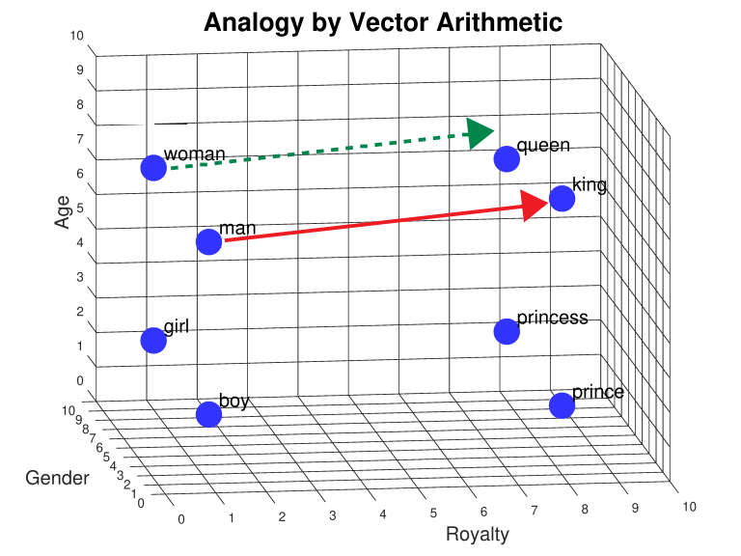
This is what you were doing inside your head:
Man is to king as…
Woman is to___________
Girl is to ___________
Boy is to ___________
Notes:
Teacher Note : This is what you were doing in your head when you completed the analogy
Explanation: You drew this arrow from man to king and then you take the arrow and shift it (no changes in the length and the direction)
We shift the base of the arrow from man to woman and look at where the tip is pointing and find the closest word to it. This is the answer to the analogy.
Vocabulary - Vector (arrow in this diagram) - has length and direction

Slide 23
What is “king” - “man” ?
 | Gender | Age | Royalty
king | 1 | 8 | 8
man | 1 | 7 | 1
king - man | 0 | 1 | 7
red arrow
Notes:
Teacher Note: This is what is happening in the computer.
King and man are both points and vectors. King from origin to the coordinates
Math to create the red arrow on previous slide

Slide 24
What is “king” - “man” + “woman” ?
 | Gender | Age | Royalty
king | 1 | 8 | 8
man | 1 | 7 | 1
king - man | 0 | 1 | 7
woman | 9 | 7 | 1
king - man + woman | 9 | 8 | 8
queen | 9 | 7 | 8
red arrow
green arrow
Notes:
This is the green arrow. Notice that the feature values for king - man + woman and queen are almost but not perfectly identical. This is why the green arrow doesn’t point directly at queen, but close to it.

Slide 25
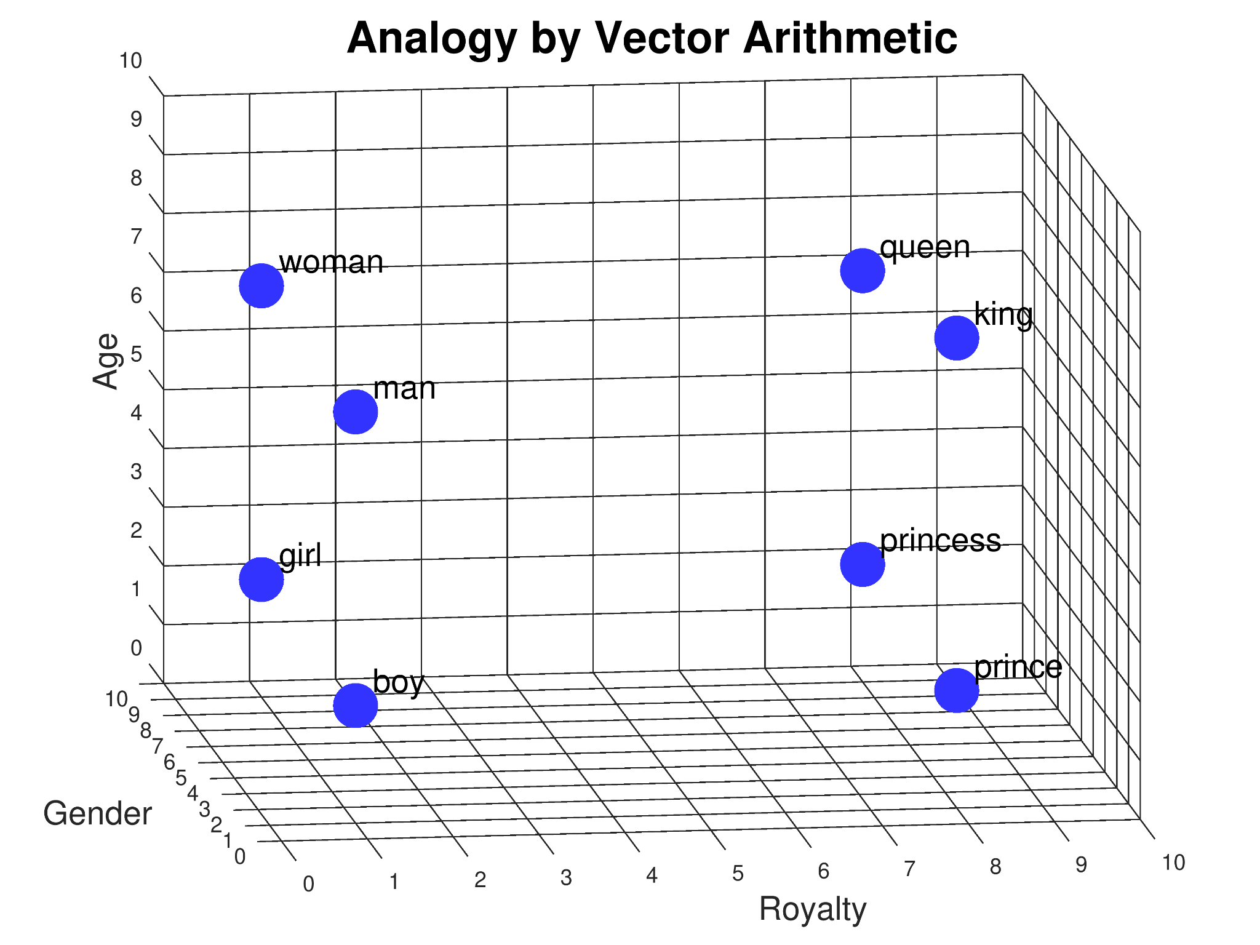
Try it:
“woman” is to “girl” as
“man” is to ______.
Draw the red and green arrows.
Notes:
New analogy for students to solve

Slide 26
Try it:
“woman” is to “girl” as
“man” is to boy .
Notes:
New analogy for students to solve

Slide 27
Try it #2:
“boy” is to “prince” as
“girl” is to ______.
Draw the red and green arrows.
Notes:
New analogy for students to solve

Slide 28
“woman” is to “girl” as “queen” is to ______.
Directions: Use the table to look up the feature values and compute the answer.
 | Gender | Age | Royalty
girl | 9 | 2 | 1
woman | 9 | 7 | 1
girl - woman
queen | 9 | 8 | 8
girl - woman + queen
Answer: ____________
red arrow
green arrow
Notes:
Student Note: The feature values for girl - woman + queen may not be identical to the feature values of the answer and thus the green arrow doesn’t point directly at the answer. Find the closest word to complete the analogy.

Slide 29
How many dimensions do we need?
How would you represent “father”, “uncle”, “sister”, “cousin”?
What dimension would you add to help you represent “cucumber”?
Your Answer: __________________________
What dimension would you add to help you represent “smile”? Or “honesty”?
Your Answer:__________________________
We need many more dimensions. Can we get the computer to help us?
Word embeddings: type of word representation that allows words with similar meaning to have a similar representation
Notes:
Teacher Note: We don’t have enough features to represent .
Notice that even if you narrowed the terms to just kinship terms 4-5 D is not enough.
To represent all the words we know we need lots of dimensions

Slide 30
How are word embeddings created?
Start with lots of text. For each word, pay attention to which words occur before it and after it. Create features that capture these statistics.
“king” and “queen” should be similar because both occur with words like “the”, “palace”, “crown”, “castle”, etc.
But they are also different because “king” occurs more with “he” and “his” while “queen” occurs more with “she” and “her”.
●●●
were | visiting | the | king | in | his | palace
●●●
●●●
reported | to | the | queen | in | her | palace
●●●
Notes:
This slide shows a 7 word sliding window. The target word is in the middle and the three words on either side provide context. The algorithm keeps track of all the words that occur in the context of the target word.
“king” and “queen” can be inferred to be nouns because they appear after “the”.
Whoever is creating the embedding starts by choosing a large text corpus, e.g., all of Wikipedia, or a huge collection of news stories. They then choose an algorithm (there are many), and tun the algorithm on the text to get back a set of embedding vectors.

Slide 31
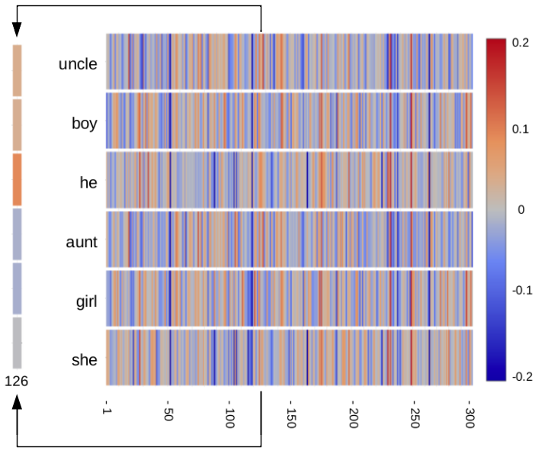
https://www.cs.cmu.edu/~dst/WordEmbeddingDemo
A 300
Dimensional word embedding used in the online “WordEmbeddingDemo”.
feature
Notes:
This diagram shows 300-dimensional word embedding vectors that were created using a corpus of Wikipedia articles and news stories.
Explainability - for these 6 words, feature 126 (out of 300) has positive values (tan/orange color) for male words and negative values (blue/gray color) for female words.

Slide 32
Introduction to Dave’s Word Embedding Demos
& Student Activities
Notes:
Introduce to the word embedding demo (Video)
Open demo
Look at it.
THe right hand side is the 300 D feature space.

Slide 33

Introduction to the 3D Semantic Space
Watch It
Try It: 3D Semantic Space
Get comfortable interacting with the demo
  Rotate the word display
  Zoom in and out
Hover over a word to see which words are closest to it
Add new words
  Does the demo know that word?
  The demo has a 50,000 word vocabulary, so it doesn’t know all words
Add related words (e.g., apple, cherry, orange, lemon, and lime) and see how they cluster.
Word Embedding Demo, Part 1 (3:37)

Slide 34
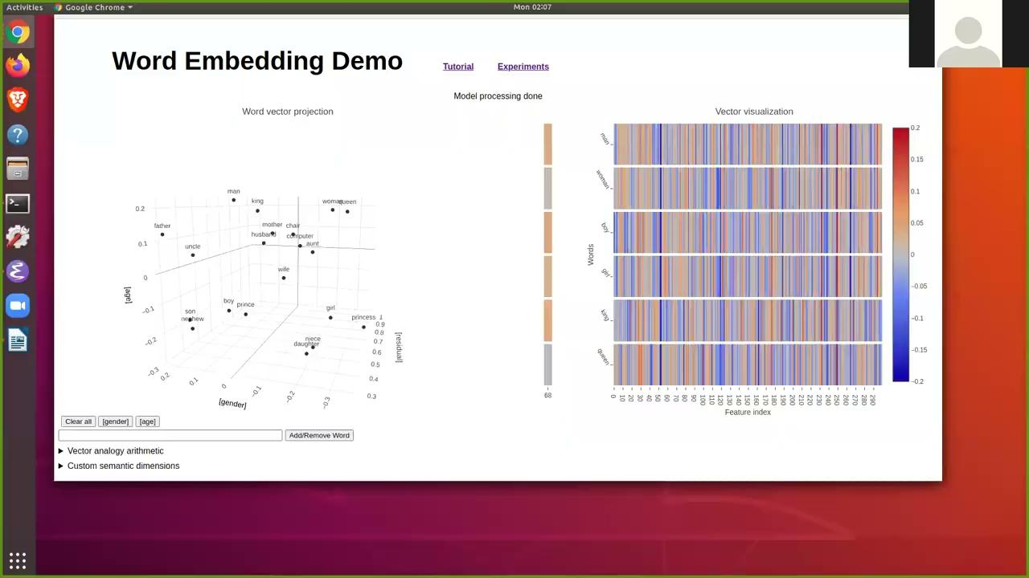
Introduction to the Feature Vector Display
Watch It
Try it: Vector Visualization
Drag the mouse across a word and look at its feature values.
Observe the relationship between the numerical value and the colors
  The more positive the number the redder it should be
  The more negative the bluer it should be
  Zero is gray
Compare the feature vectors of two words that have similar meanings
  Try boy and girl - What do you notice
  Try another pair of words
Replace a word in the feature vector display
  Look at the features of the word
  Compare it to another word, what do you notice?
Choose a specific feature (gender is 126), see how the value differs for different words, are the values of the features marked correctly?
  Check out 121, what do you think that feature might be related to.
Word Embedding Demo, Part 2 (2:56)
Notes:
Teacher Note: #2 - if students compare boy and girl they should be similar but there are places they disagree.
#4 - 121 might be royalty

Slide 35
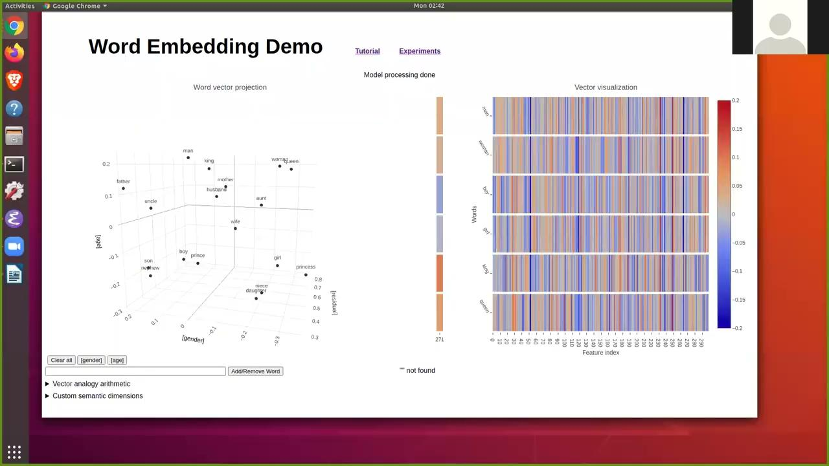
Introduction to Analogies
Try it: Analogies
Start by trying the analogies in the video and rotate and zoom so you can see what the 3D positioning of these words looks like
  man is to king as woman is to ______
  What do you notice?
  cat is to cats as goose is to ________
  What do you notice?
Change the Age semantic dimension to Number
  What do you notice now about the positions of singular versus plural
  Add additional words to the semantic space, what do you notice
Create your own analogies and see if the demo finds the answer that you expect.
  ________ is to______as ______ is to ______
  What do you notice?
  ________ is to______as ______ is to ______
  What do you notice?
Watch It

Slide 36
Take away
Real AI systems use word embeddings
for handling search queries
for machine translation
for intent recognition

Slide 38
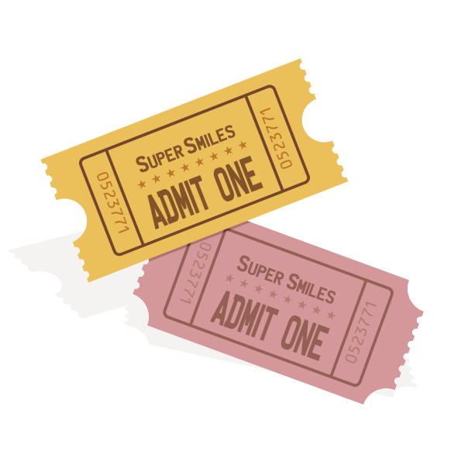
Exit Ticket
Explain: How does the computer know which words are related?

Slide 39
Limitations
Christina - turn into pictures - These were some other notes we had in the Unit 2 Overview Table
Limitations
  Homonyns - same word with same spelling or different meaning. Their statistics will be glommed together.
  Word embeddings are imperfect encoding
    Ex. apple - near chair and computer.
    What are the closet things to apple. Expect orange
    But instead it ipad, iphone cupertino
    This is because of the training data. This word embedding relates to the tech company
    Ex. man
    Man mankind
    Man adult man
    Man - verb
    Very different than woman
    Cherry - new unspoiled, flavor, fruit, color
    Peach - peachy
    Bananas - crazy
    Orange - neutral
    Plum - sweet job
    Prune - age
    Idiomatic usages, fun fact about language that we didn’t think about before.
  Biased toward cisgender.
    Gender non-binary will fit into the middle (neutral)
    They, Them, their (neutral)
Ethical issues
  Analogies -> gender and professions
    Man : doctor , woman : nurse
    Look for some of these biases.
    This comes up in google translate.
    Google image -> is something different.
Notes:
Teache Noter: The reason word embeddings are imperfect is because words have multiple senses. Humans can keep these senses separate, but if we are trying to condense this down into a 300 dimensional vector of numbers, then the different meanings are going to affect each other. You can see this in the placement of these words within the 300 dimensional space. For example, we would want all colors and fruits to have their own clusters. But in the case of cherry, it is halfway between fruit and color.
Apple was near the apple brand.

Slide 40
Ethical issues
  Analogies -> gender and professions
    Man : doctor , woman : nurse
    Look for some of these biases.
    This comes up in google translate.
    Google image -> is something different.
Notes:
Teacher - the bias reflects the text that the word embeddings were trained on. If the text that we trained it where all the doctors are men then it will be men.
This diagram shows 300-dimensional word embedding vectors that were created using a corpus of Wikipedia articles and news stories.

